Slide 1

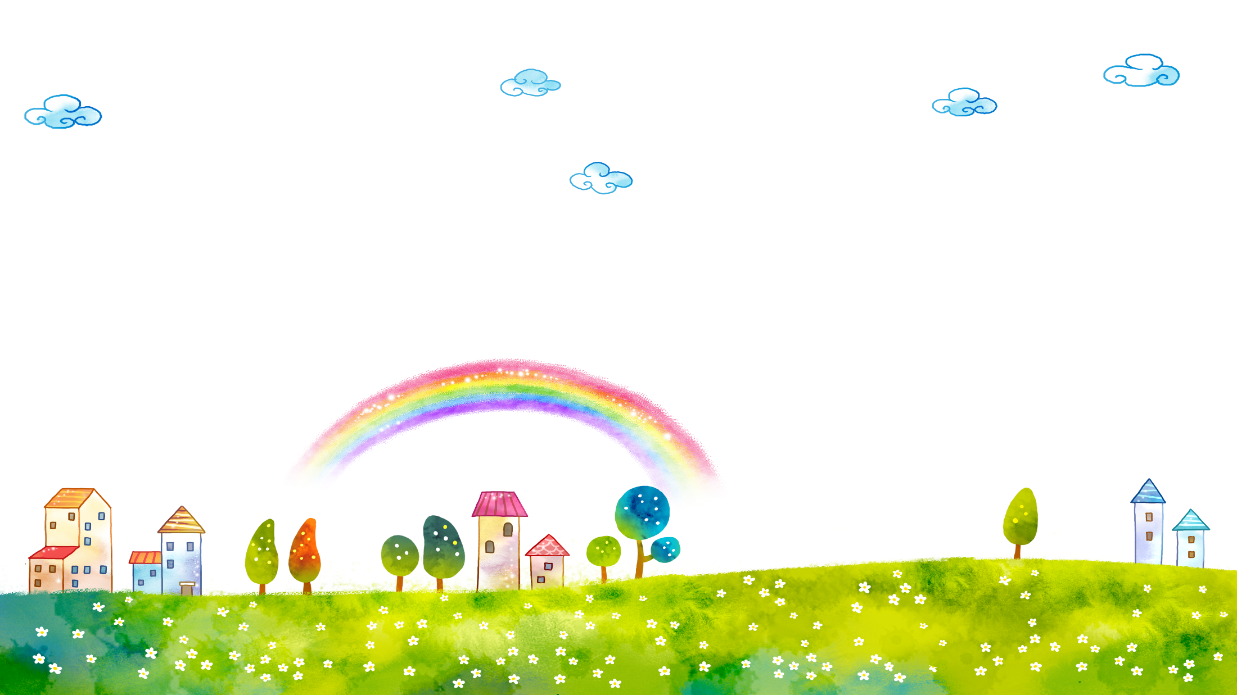
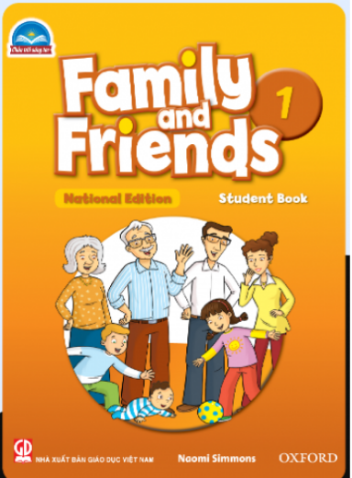
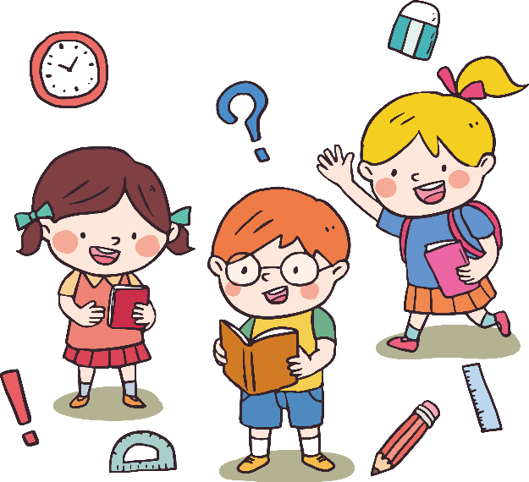
FAMILY &FRIENDS 1
National Edition

Slide 2
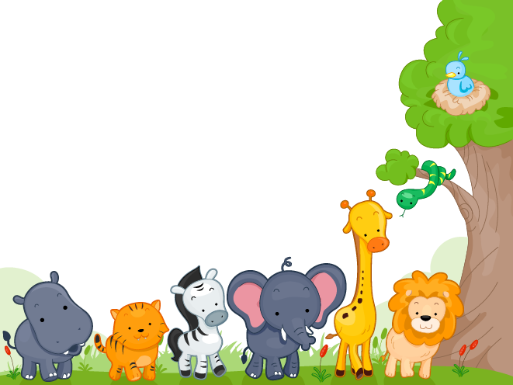

UNIT 4 : THEY’RE BEARS !
LESSON 3 : SOUNDS and LETTERS

Slide 3

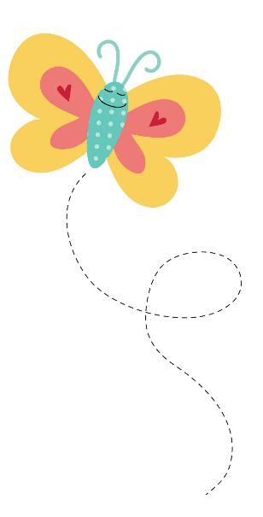



WARM UP

Slide 4




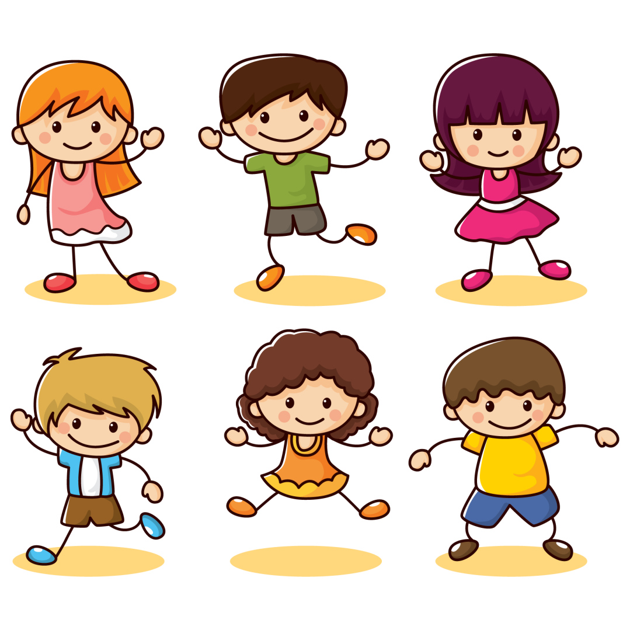

CLAP
THE BOARD

Slide 5
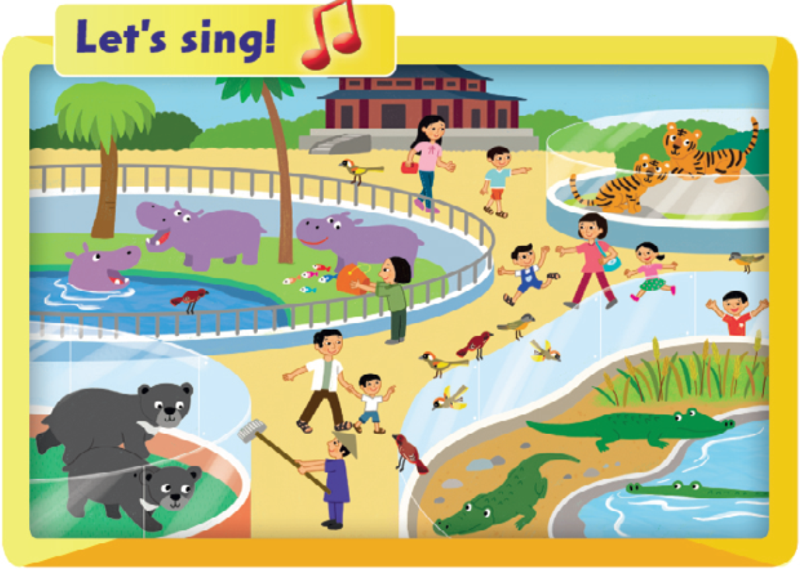



Notes:
- Place Flashcards 27-31 around the classroom.
- Play the song from Lesson 2 (Track 53) of the unit.
- Students point to the correct flashcard when they hear the word.

Slide 6

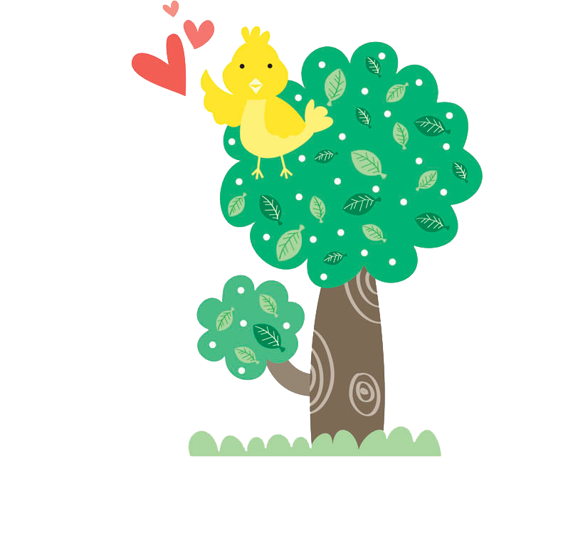
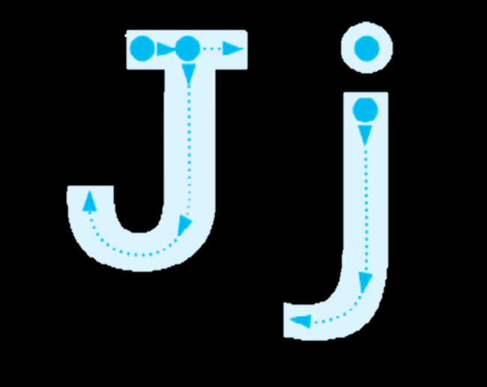
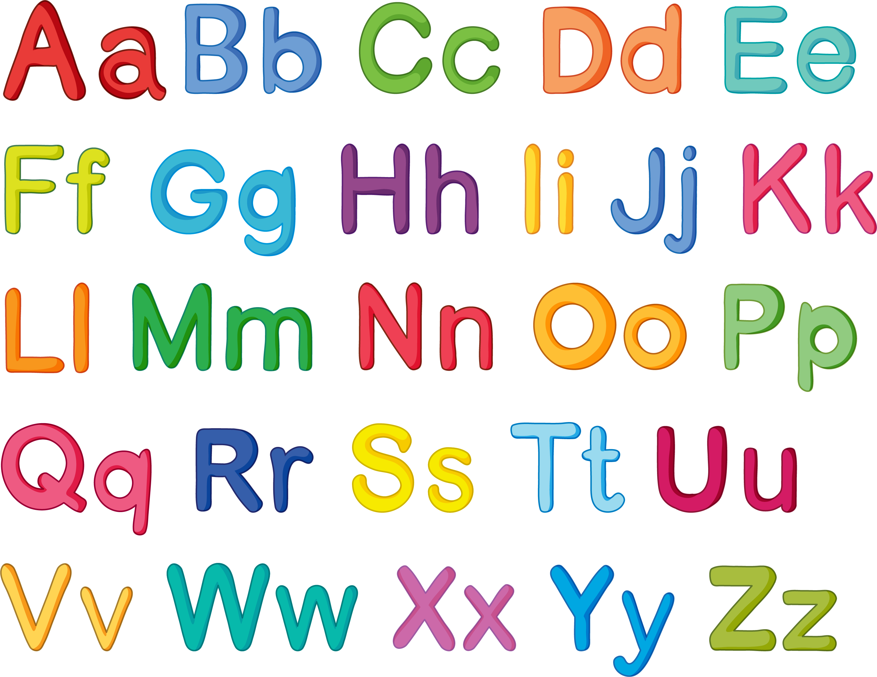

Notes:
- Show the uppercase J and lowercase j.
- Say the sound /dʒ/.
- Draw dotted outlines of the uppercase J and lowercase j on the board.
- Ask different students to come to the board and connect the dots.
- Continue with the letter K and sound /k/

Slide 7


Notes:
TRACING LETTER

Slide 8
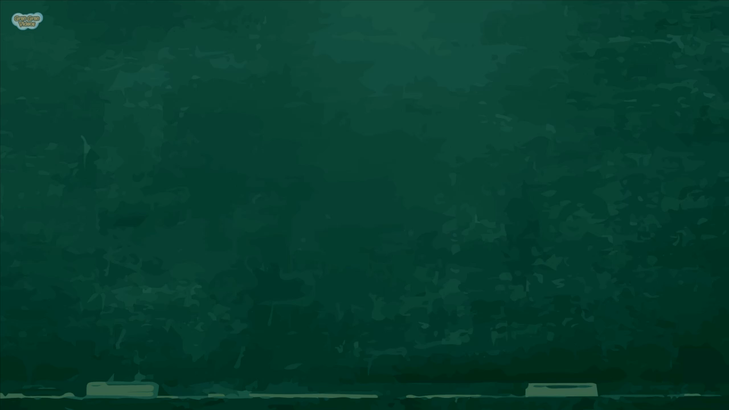

Slide 9


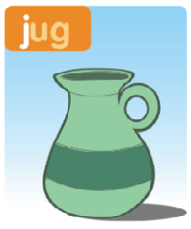
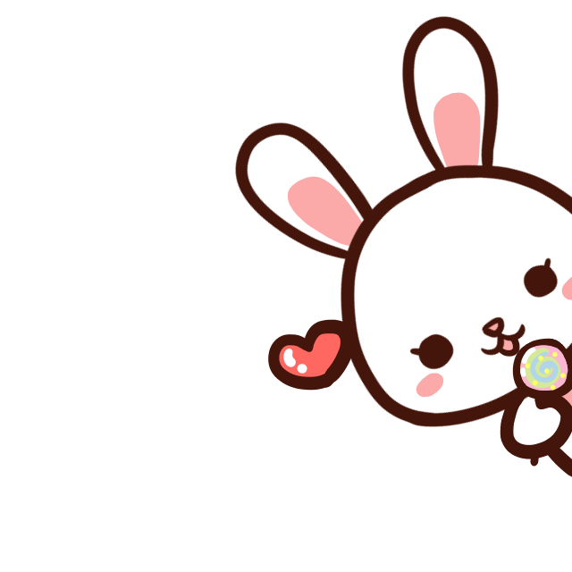
J
Notes:
Listen, point, and repeat. Write. Track 54
- Play track 54, listen and point
- Play again, ask students to listen and point
- Play again, ask students to listen and repeat
- Model the writing activity
Below level:
- Practice the words and sounds again by handing out the phonics cards to four different students. They must stand up with their card when they hear their word.
- Change students and repeat several times.
At level:
- Have children work in pairs, and stand one behind the other.
- Invite one child in each pair to trace a letter ( j or k) on their partner’s back. The other child guesses the letter.
Above level:
- Continue with the ‘At level’ activity but encourage children to add in other letters they know.

Slide 10

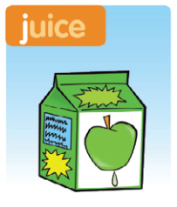
J

Slide 11
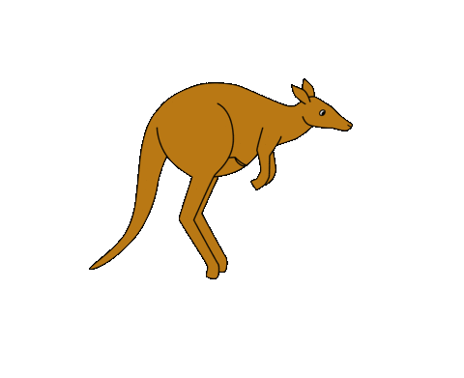
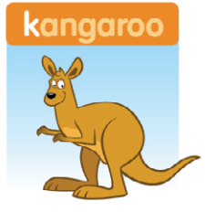

k

Slide 12


k

Slide 13
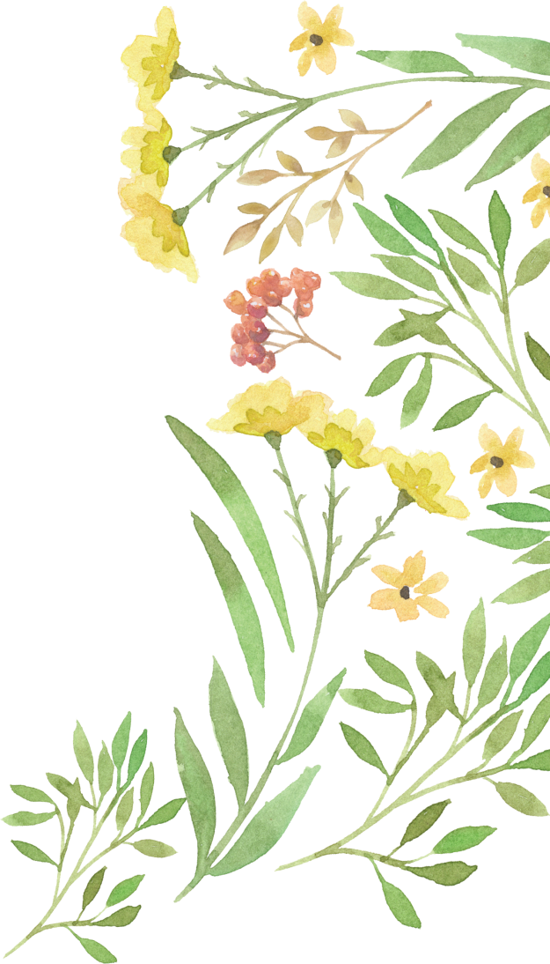
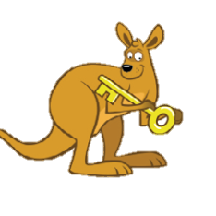

Notes:
Listen and chant: track 55
- Point to the picture and say: Juice in a jug. and Katy the kangaroo has a key.
- Play the recording, ask students to listen to the chant.
- Put Phonics cards 19-22 in different places around the room.
- Play the chant again
- Students point to the cards.
- Play the chant again, pause for students to repeat.

Slide 14


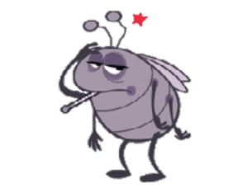

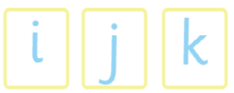

Notes:
Stick and say.
- Point to the pictures one at a time and elicit the words ill, kangaroo and jug.
- Point to the letters under the kangaroo and say the sound /k/ – kangaroo. Then elicit /dʒ/ – jug for the next picture.
- Say Let’s stick! Hold up the K sticker and model placing it in the book in the correct position, while saying /k/.
- Put it on the letter k under the picture of the kangaroo. Say /k/ – kangaroo. Children copy and repeat in chorus.
- Continue with J
- Students work in pair to stick and say

Slide 15
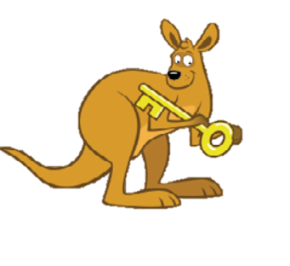
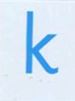

Slide 16


Slide 17

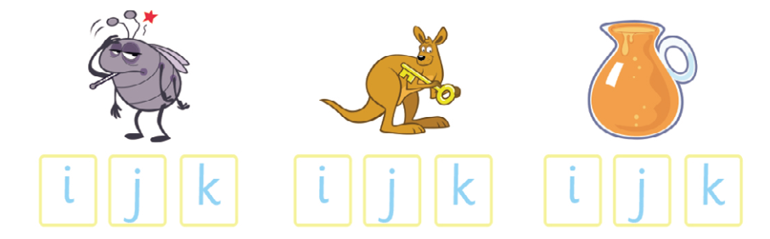

Slide 18
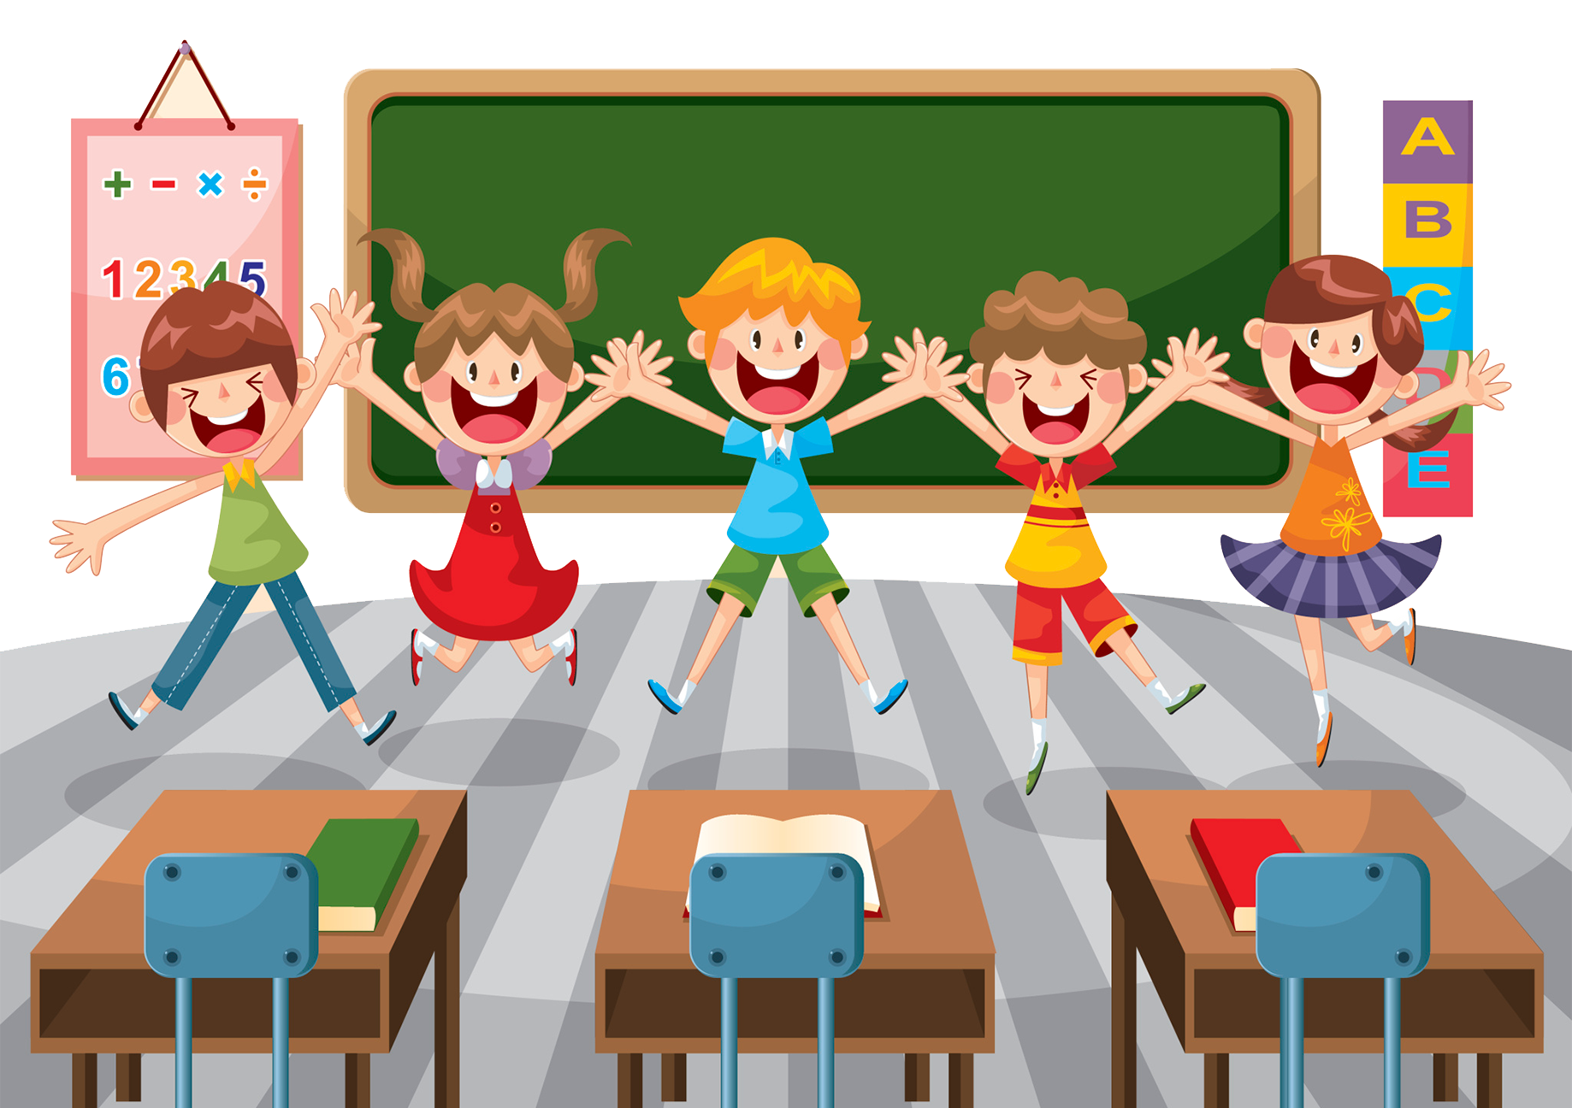
Goodbye !

